Slide 2
Link to presentation:
go.uen.org/bwL

Slide 3
UtahFutures Update
UtahFutures has received one-time funding of $1.6 million.
This funding will allow UtahFutures to continue to provide, free of cost, high quality college and career planning resources to all Utah residents.

Slide 4
UtahFutures Updates
StepUp to Higher Education transitioning to UtahFutures
Launch My Career ROI Tool
Updates to current UF assessments and pages
Growing Partnership with Keys to Success

Slide 5
WHY IS STEPUP TO HIGHER EDUCATION MOVING TO UTAHFUTURES?
Create a central website for middle and high school students, parents and other adults to find college and career readiness information.
Expanded usage of personnel and resources
Better collaboration and a more efficient approach to outreach events and communication.

Slide 6
What You Will See.
90% of the StepUp content will transition by the end-of-month.
Concurrent enrollment database, utahmajors.org, access network search tool will transition during the summer.

Slide 7
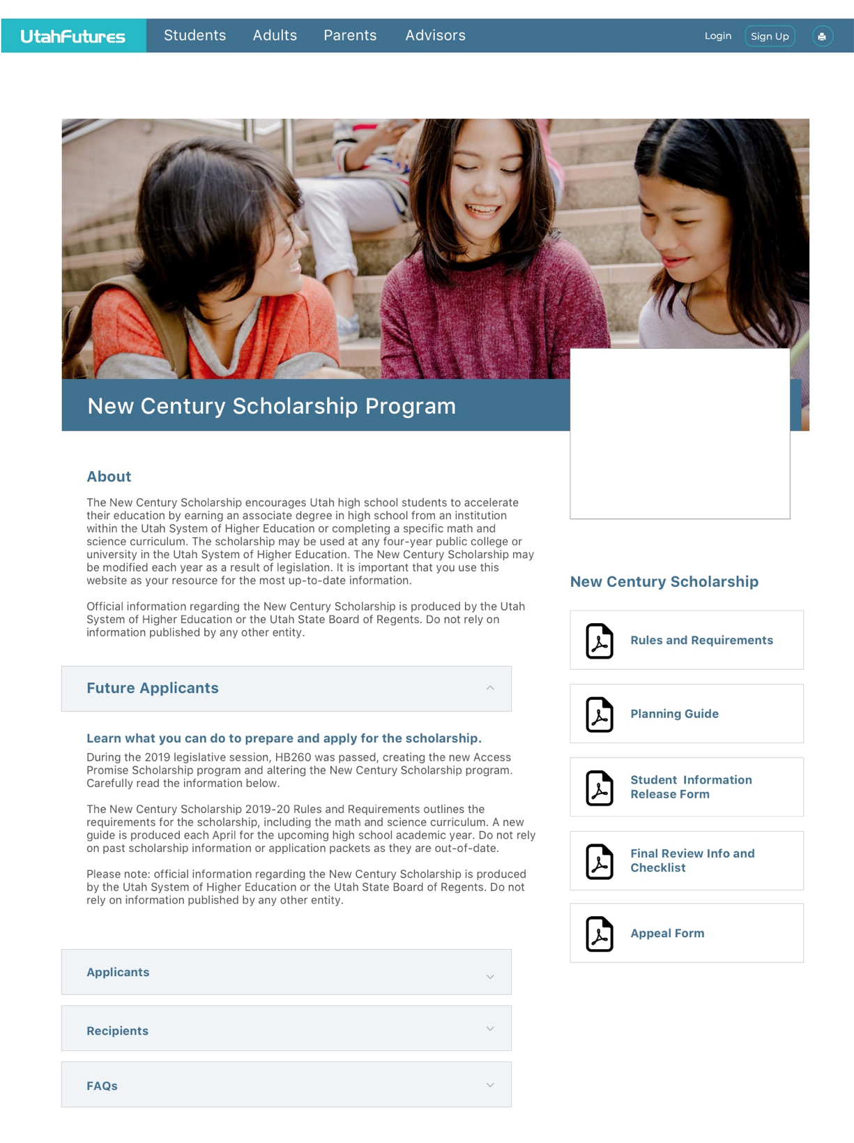
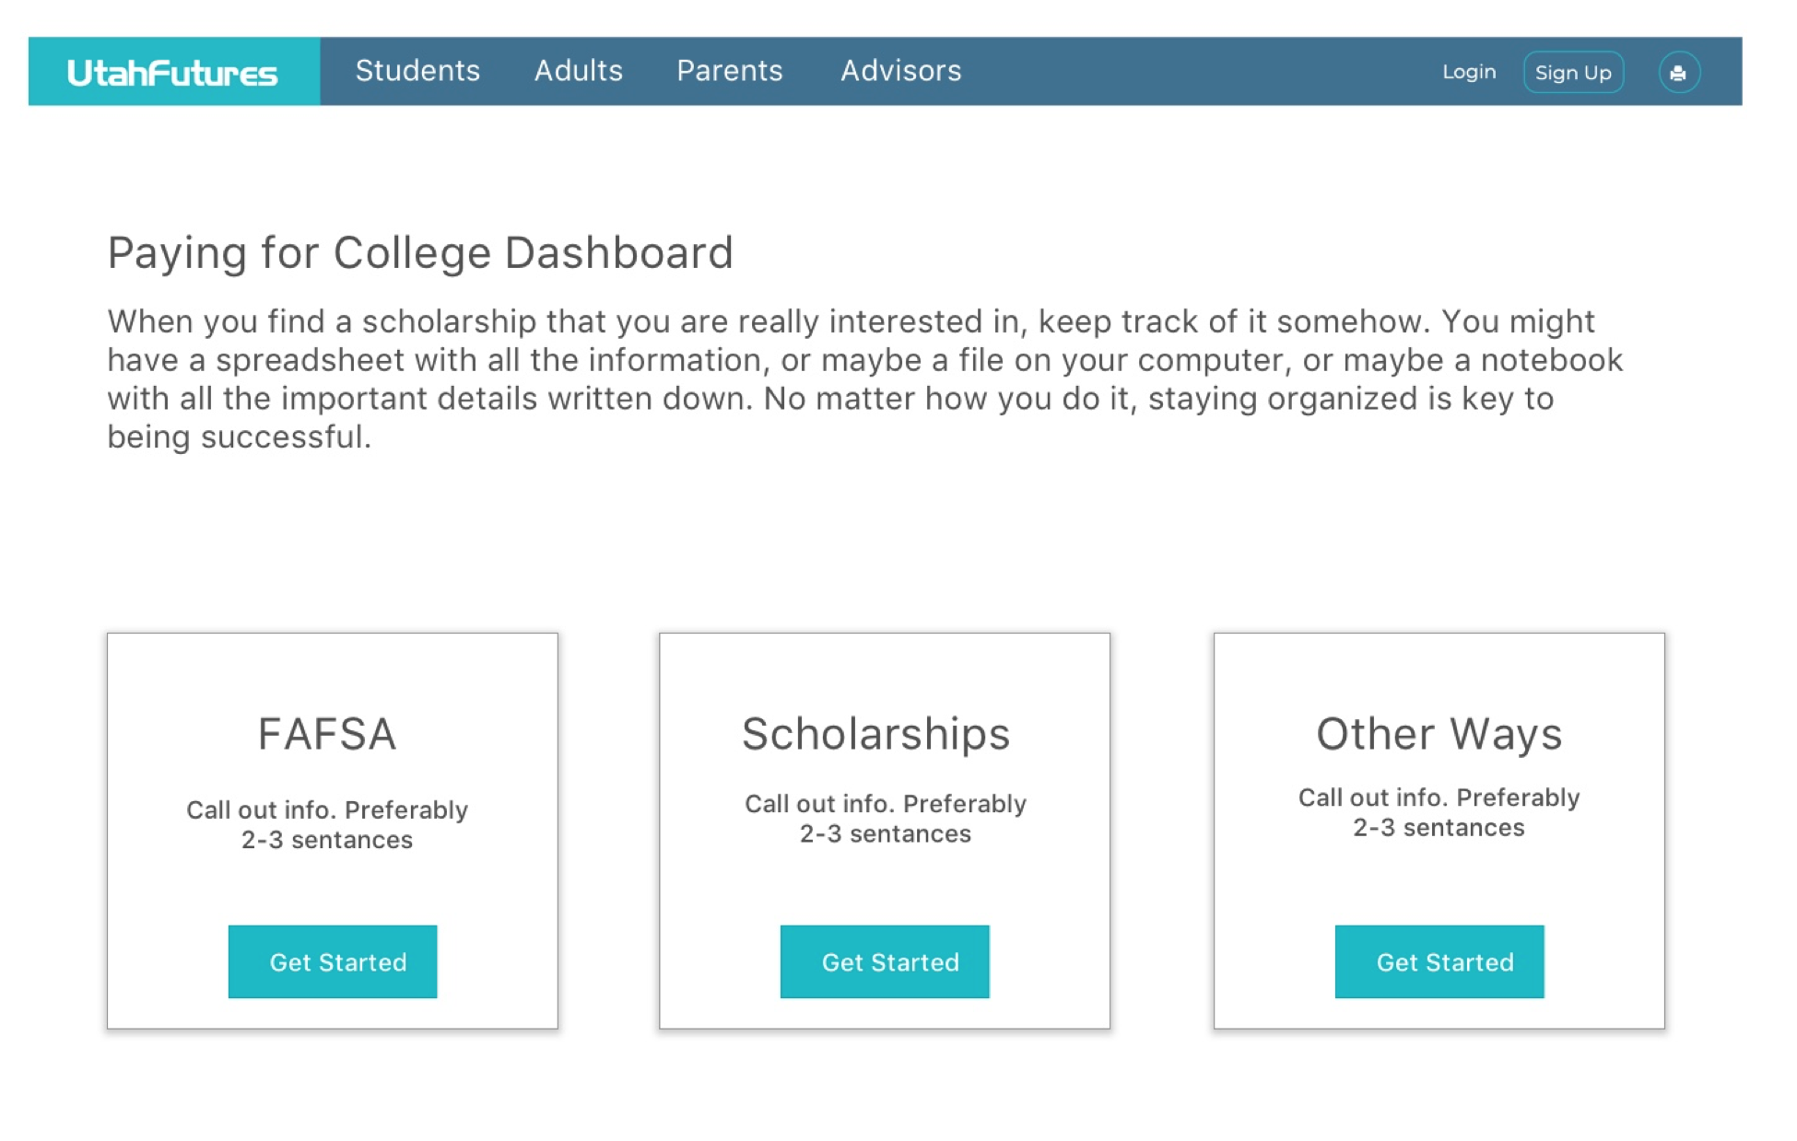
Regent’s & New Century Scholarship Info
FAFSA completion resources
Grade-level checklists

Slide 8
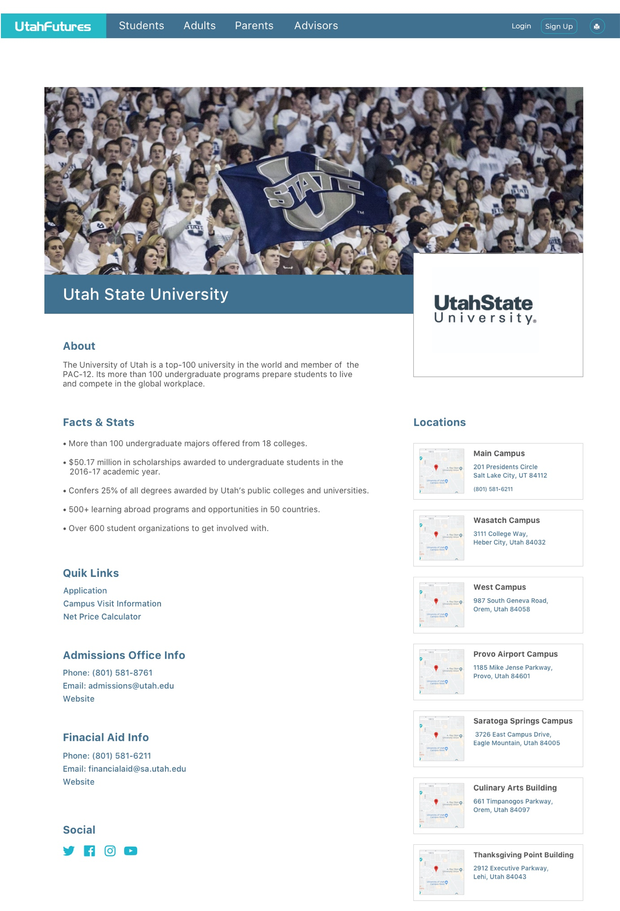
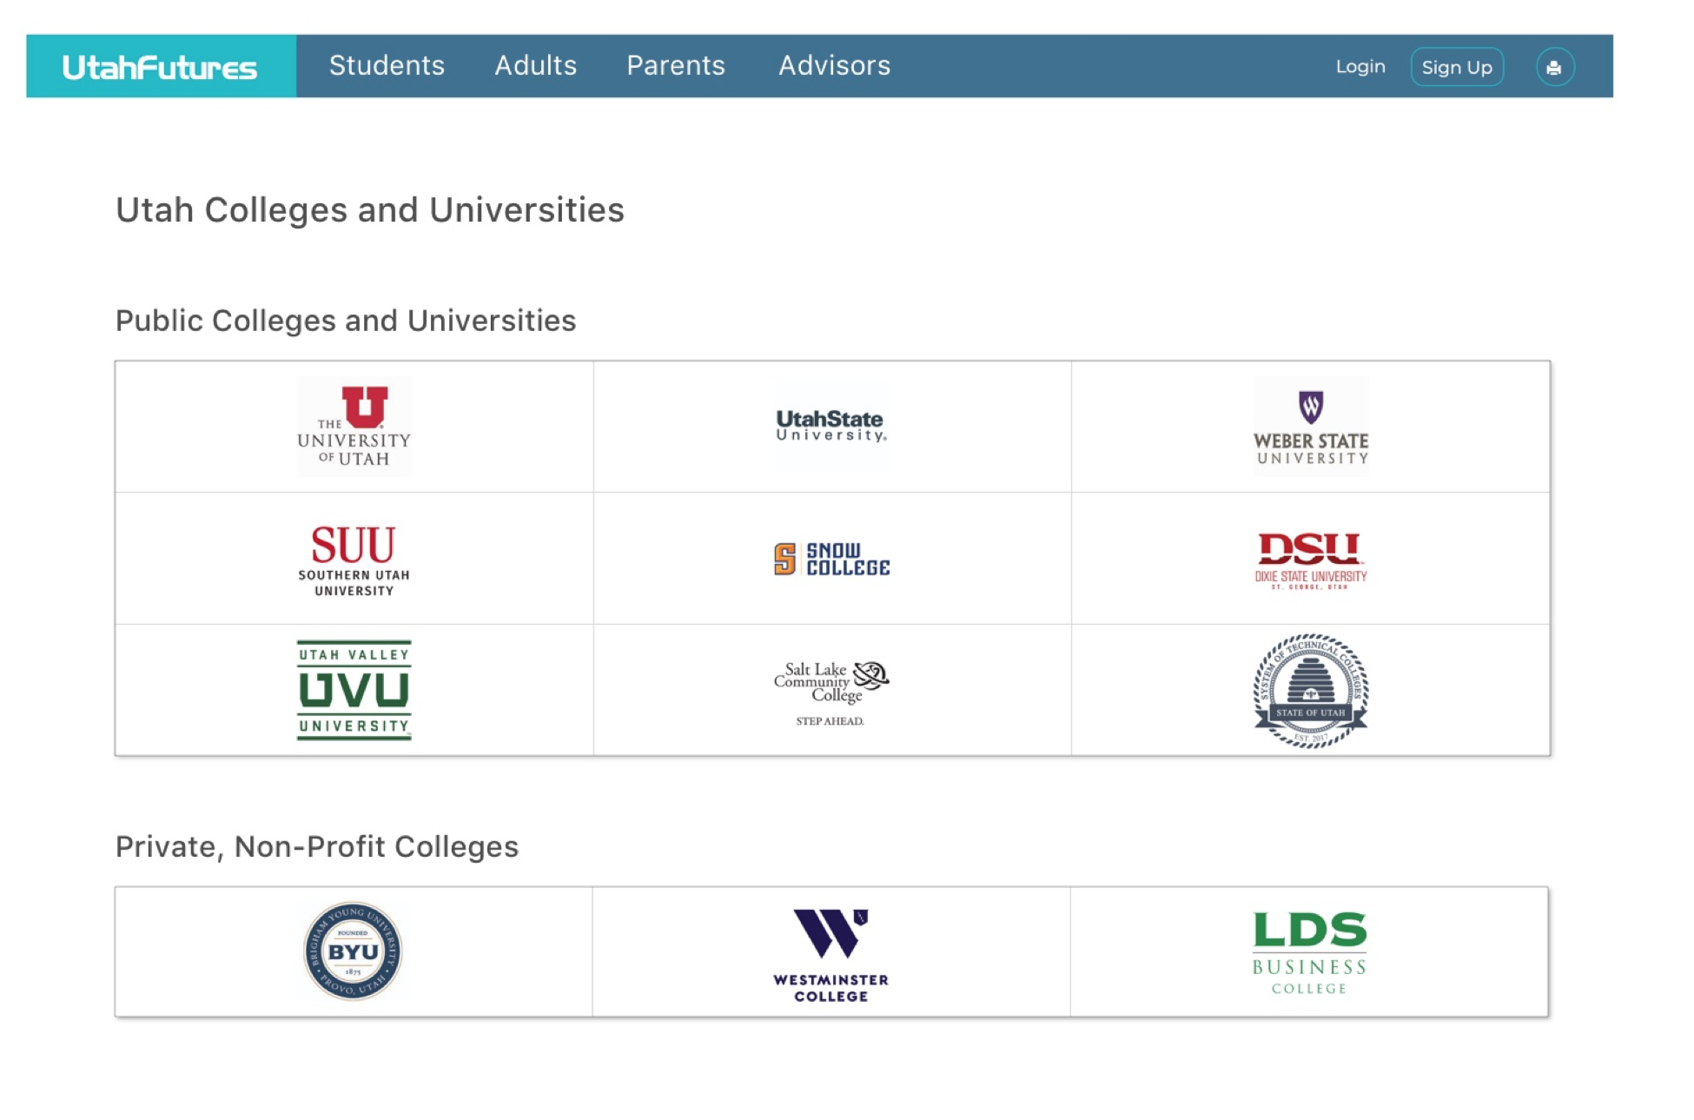
College Directory
College planning materials and events

Slide 9
YOUR CONTACT PERSON AT STEPUP WILL NOT CHANGE!

Slide 10
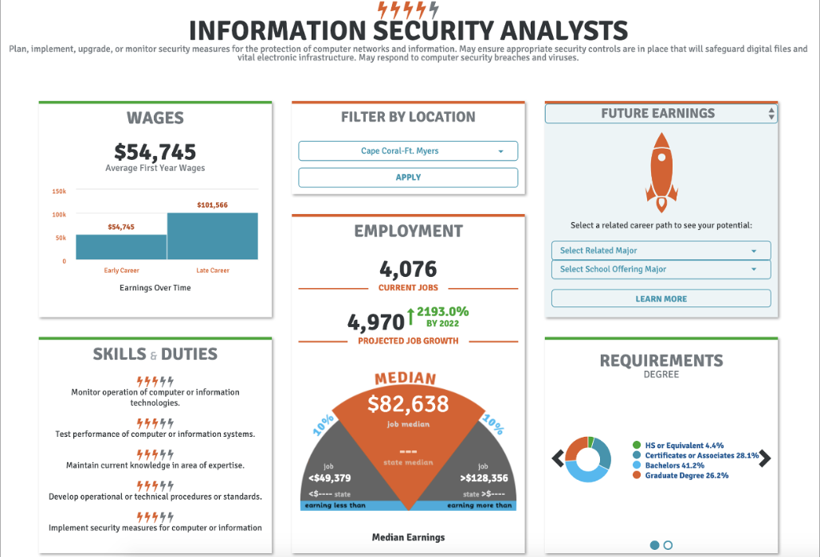
Launch My Career
Launch My Career measures college value to help students and their families...make more informed decisions about the training and skills that provide the greatest value to students and their communities.
Test is out: Launch My Career *There are still glitches in this data. This link is only to test the tool!

Slide 11
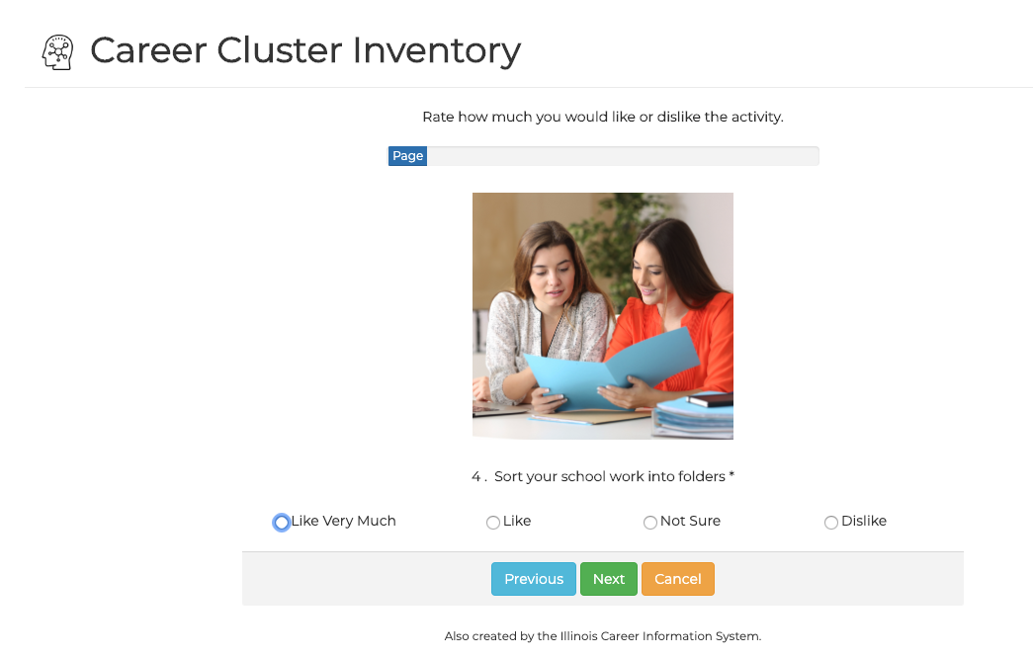
UtahFutures Page Updates

Slide 12
New UtahFutures Training Coming in August!
Updated College and Career Readiness with UtahFutures online course
Register Here
Open Entry, Open Exit
On-site Training for 8+ participants
Watch your email for updates
Request a Training
For Monthly Updates on UtahFutures, Subscribe to the UtahFutures mailing list

